Slide 1


Online Retail Store Data Visualization
Raja Sekhar Rapaka

Slide 2
Introduction
The virtual experience program is provided by Tata and Forage. I discover how passionate, multidisciplinary experts utilize data visualization technologies like Tableau and Power BI to take on some of the most difficult business problems and uncover fascinating insights in the data.
The program demonstrates the kind of issues dealt with by Tata Insights and Quants every day and makes an effort to imitate the difficulties an individual could have.
There are 4 modules in this virtual experience program.
Framing the Business Scenario
Choosing the Right Visuals
Creating Effective Visuals
Communicating Insights and Analysis
Data Cleanup
Quantity should not be below 1 unit
Unit price should not be $0
Project Link

Slide 3
Questions from the given data
CMO Questions
Which product has the highest purchase rate and how often are they purchased?
What is the repeat customer rate?
How long does it take the repeat customer to purchase a product after their initial purchase?
How does the product with highest purchase rate perform in every region?
CEO Questions
What is the monthly sales breakdown, which month has the highest revenue and lowest revenue?
What is the quarterly revenue breakdown? Does the annual season affect the revenue?
Which region generates the highest revenue and which region generates the lowest?
Are there customers that have significant impact on revenue or is the customer base more diverse.

Slide 4
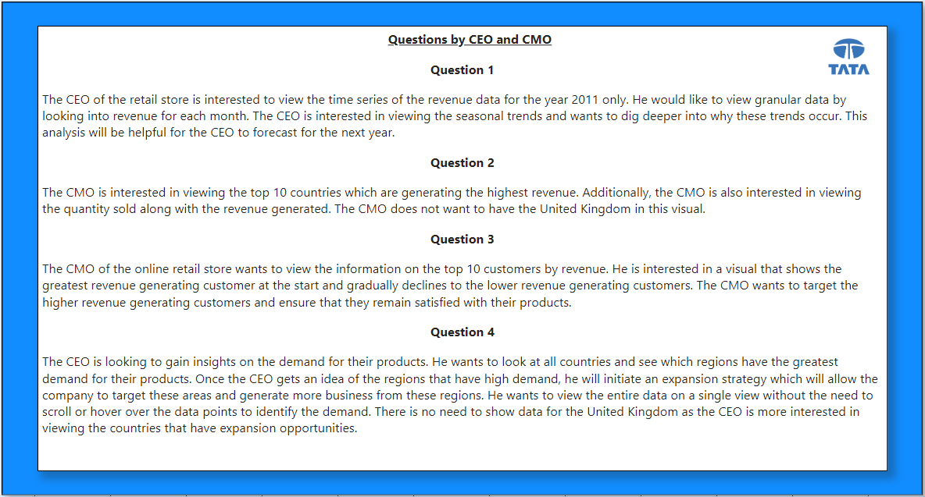

Slide 5
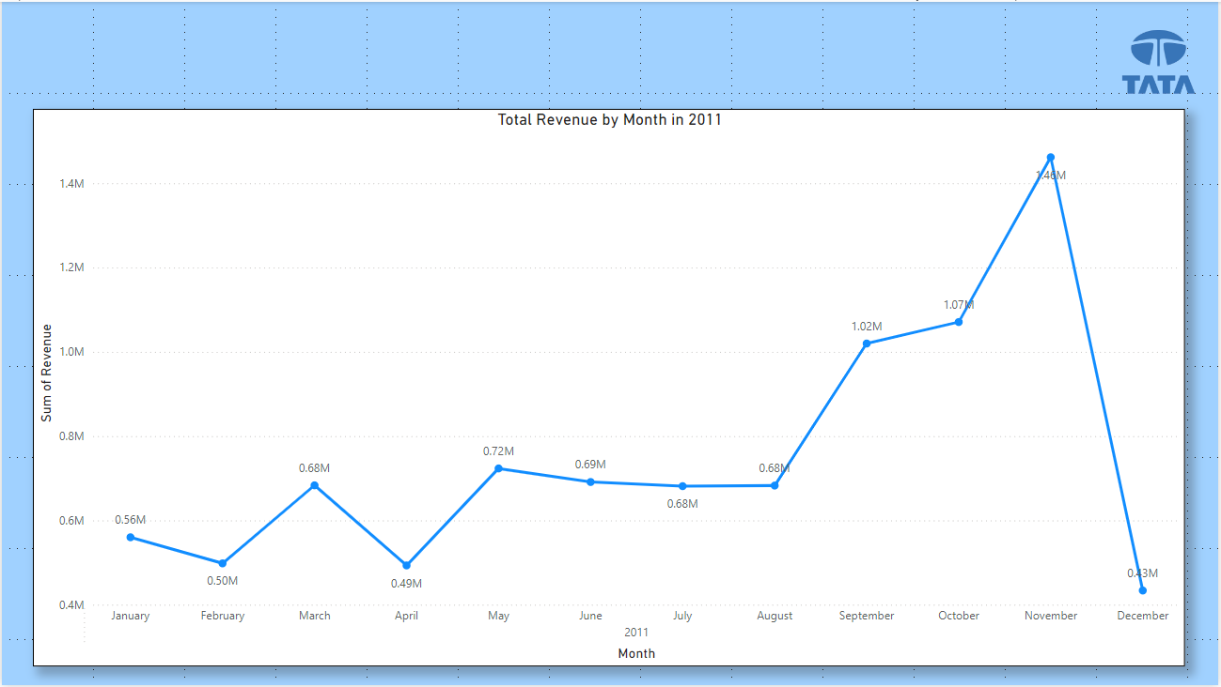

Slide 6
Insights from the Total Revenue by Month in 2011 Graph :
Overall Revenue Trend :
The graph shows a significant increase in total revenue from January to November 2011, peaking in November. However, there's a sharp decline in December, suggesting a potential seasonal fluctuation or unforeseen event impacting revenue.
Monthly Fluctuations :
While there's an overall upward trend, the graph also reveals monthly fluctuations. Some months, such as April and August, experienced slight dips in revenue compared to their preceding months.
Peak Revenue Month :
November 2011 was the most successful month in terms of revenue generation, with the highest total revenue recorded. This peak might indicate a successful marketing campaign, product launch, or favorable market conditions during that period.

Slide 7
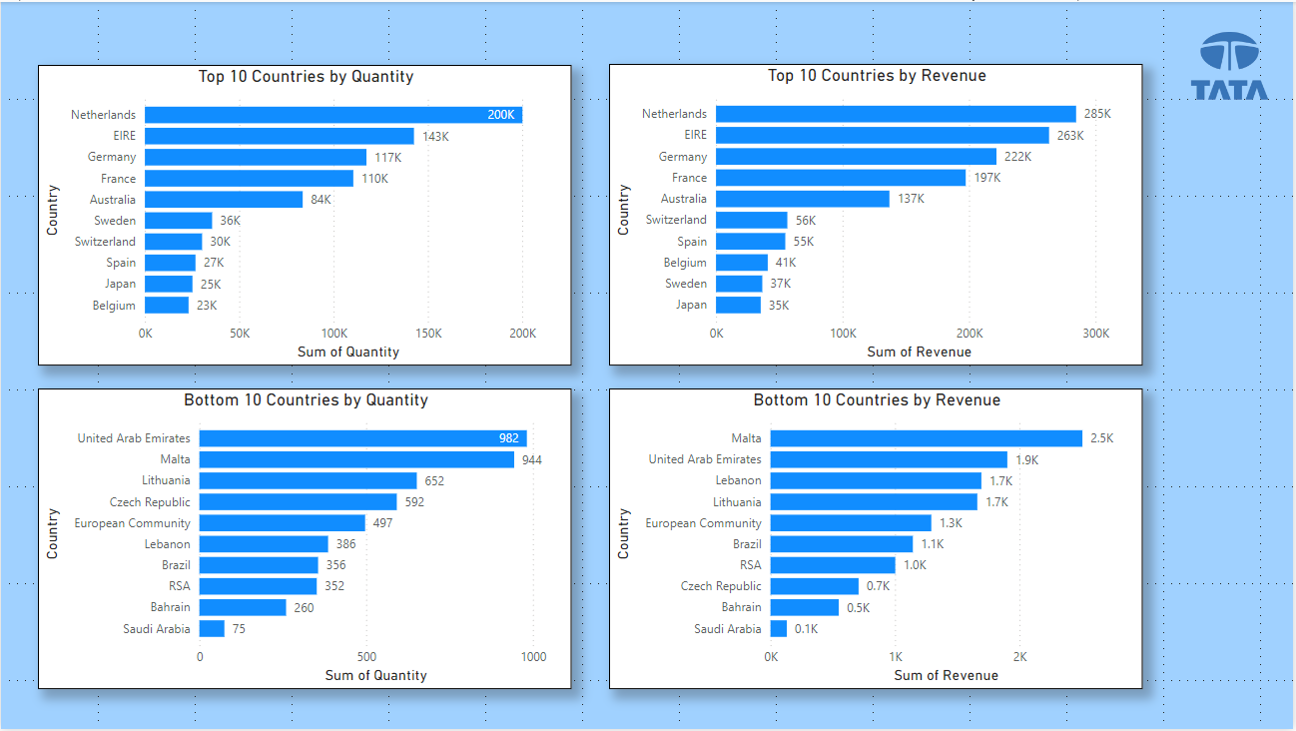

Slide 8
Insights from the Top and Bottom 10 Countries by Quantity and Revenue Graph :
Netherlands Dominates Both Quantity and Revenue :
The Netherlands consistently ranks first in both the top 10 countries by quantity and revenue, indicating its significant market share and performance.
Quantity vs. Revenue Discrepancies :
While some countries appear in both the top 10 by quantity and revenue, there are notable differences in rankings. For example, EIRE is the second-highest in quantity but ranks third in revenue, suggesting that EIRE might sell products with lower average prices or focus on a larger volume of lower-value items.
Bottom 10 Countries: Diverse Performance :
The bottom 10 countries show varying levels of performance in quantity and revenue. Some countries, like the United Arab Emirates, rank high in quantity but low in revenue, possibly due to selling products with lower profit margins. Others, like Malta, rank high in revenue but low in quantity, indicating they might focus on high-value products or have a more concentrated customer base.

Slide 9
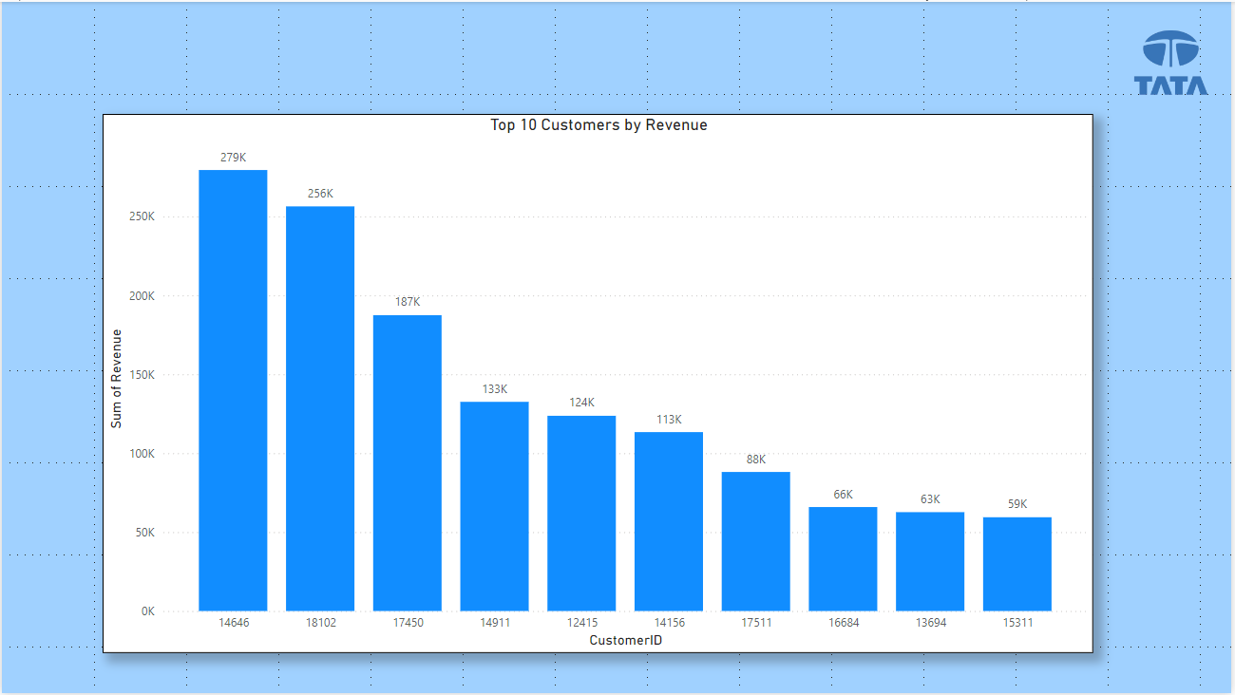

Slide 10
Insights from the Top 10 Customers by Revenue Graph :
Customer 14646 Leads in Revenue :
Customer 14646 significantly outperforms the other customers in terms of total revenue generated, indicating a high-value customer or a strategic partnership.
Revenue Concentration :
The top three customers (14646, 18102, and 17650) account for a substantial portion of the total revenue, suggesting that the company might be heavily reliant on a few key customers.
Revenue Distribution :
While the top customer generates significantly more revenue, there's a relatively even distribution among the remaining customers, indicating a diversified customer base with a mix of high-value and mid-value customers.

Slide 11
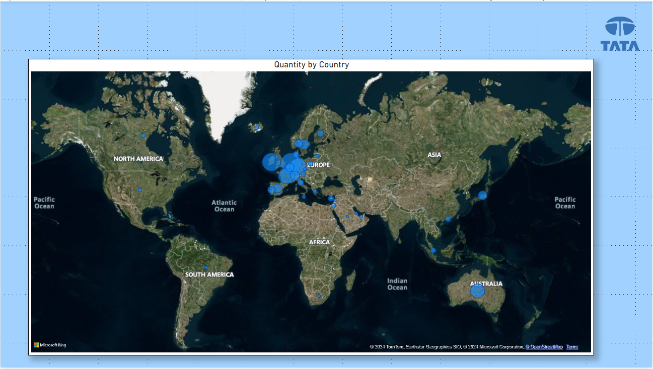

Slide 12
Insights from the Quantity by Country Map :
Regional Concentration :
The map reveals a significant concentration of sales in Europe, particularly in Western and Central Europe. This suggests that the company's market penetration in these regions is higher compared to others.
Sparse Distribution :
The distribution of sales in other regions, such as North America, Asia, and Africa, appears to be more sparse. This indicates that the company may have limited market presence or face challenges in these regions.
Australia as a Potential Market :
While the distribution of sales in Australia is relatively small, it's worth noting as a potential market for expansion. The presence of sales in Australia suggests that there's a demand for the company's products in the region.

Slide 13
Additional Visuals
Top 10 Countries by Monthly Revenue
Top 10 and Least 10 Products by Revenue with Pareto % for each Country

Slide 14
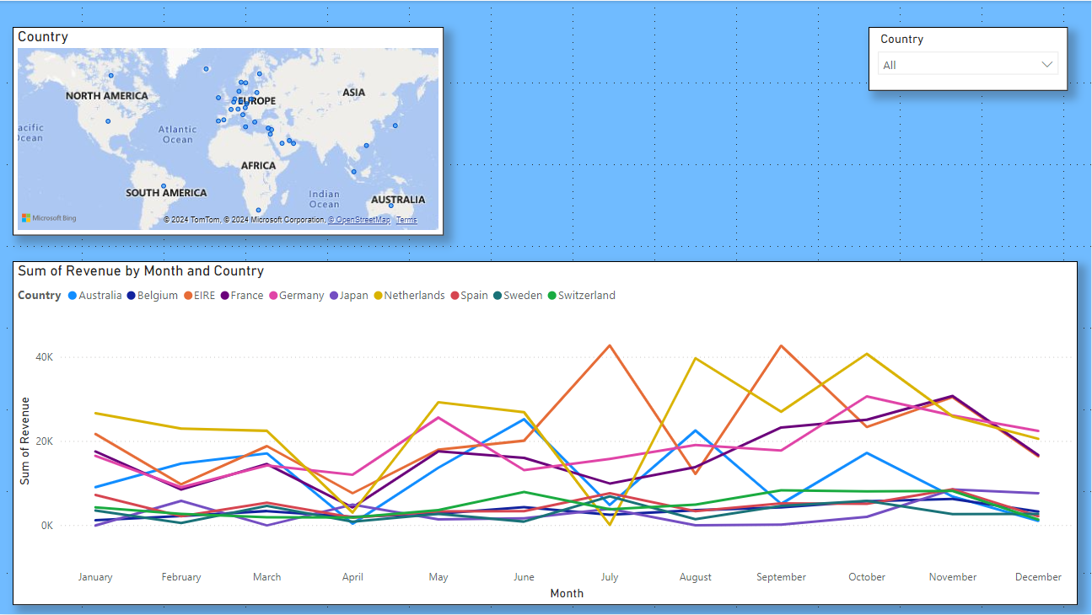

Slide 15
Insights from the Sum of Revenue by Month and Country Graph :
Country-Specific Revenue Trends :
The graph reveals distinct revenue patterns for each country. Some countries, like Germany and the Netherlands, show consistent growth throughout the year. Others, such as Spain and Switzerland, experience fluctuations with periods of growth and decline.
Seasonal Variations :
While country-specific trends are evident, there also seems to be a general seasonal pattern, with revenue tending to increase in the later part of the year (September to December) and decrease in the early months.
Relative Performance :
The graph allows for a comparison of revenue performance across countries. For example, Germany consistently outperforms other countries, while Switzerland's revenue is more volatile. This information can be valuable for identifying top-performing markets and understanding regional variations in demand.

Slide 16
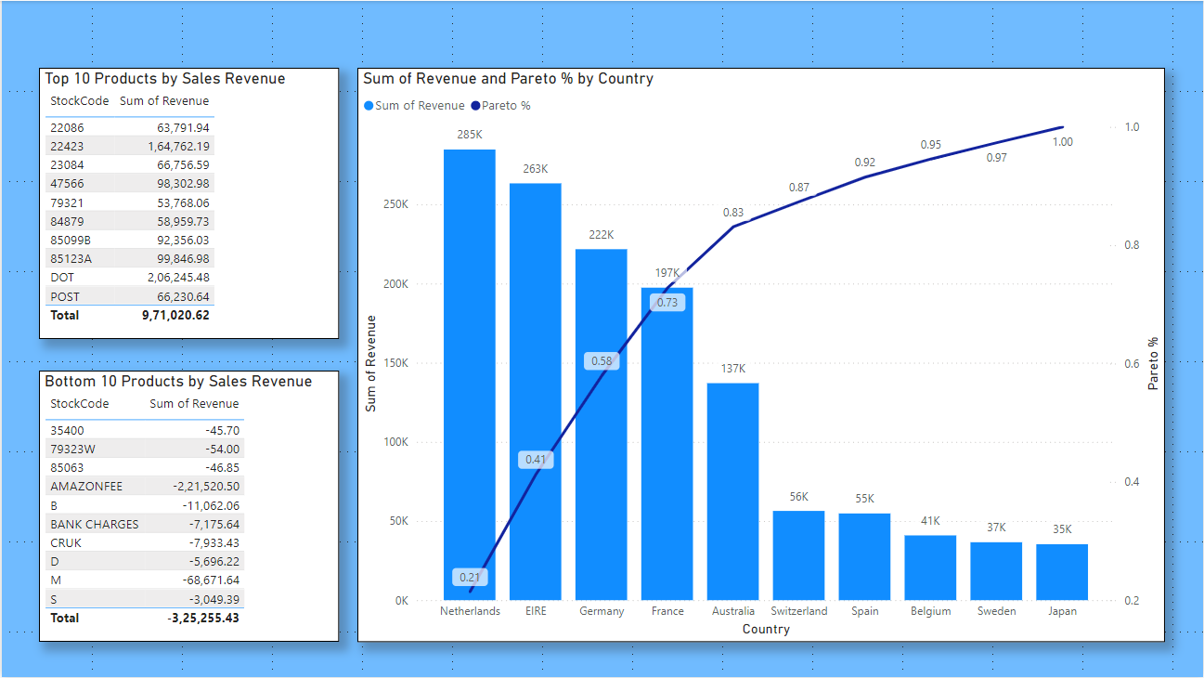

Slide 17
Insights from the Pareto Chart and Product Revenue Data :
Product Concentration :
The Pareto chart illustrates that a small number of products contribute to a significant portion of the total sales revenue. This suggests that the company might benefit from focusing on these high-performing products.
Top-Selling Products :
The top 10 products by sales revenue, as listed in the table, provide specific details about the most successful products. This information can be used to understand customer preferences, optimize marketing efforts, and identify potential product extensions.
Negative Revenue Products :
The bottom 10 products, which generate negative revenue, indicate areas where the company might be facing challenges or losses. Investigating these products could reveal issues such as pricing, product quality, or marketing inefficiencies that need to be addressed.

Slide 18
Recommendations
The company should come up with strategies that aim at stocking and advertising seasonal products to maximize sales when the demand for these goods goes up.
The company should do deeper analysis of products that are usually in high demand during low sales months to come up with strategies for marketing these products.
A deeper dive into the type of products and the revenue generated from these products for each region would be key in guiding region specific marketing strategies.
The company should consider incentivizing top revenue generating customers to strengthen the relationship with these customers.
The European market has more potential for growth and the company should aim at strategies that will increase its market positioning in the region.

Slide 19
Thank You

